Slide 1
Rural Food Processing
9 October 2019
ME 476C - Team Cocoyam
Samantha Morrison - Project Manager
Nygel des Vignes - Financial Manager
Musab Al-Balool - Manufacturing Engineer
Humoud Alanjari - Logistics Manager

Slide 2
Outline of Presentation
9 October 2019
Project Description
Concept Generation
Concept Evaluation
Rough CAD Design
BOM and Budget
Questions
Citations
Morrison 2

Slide 3
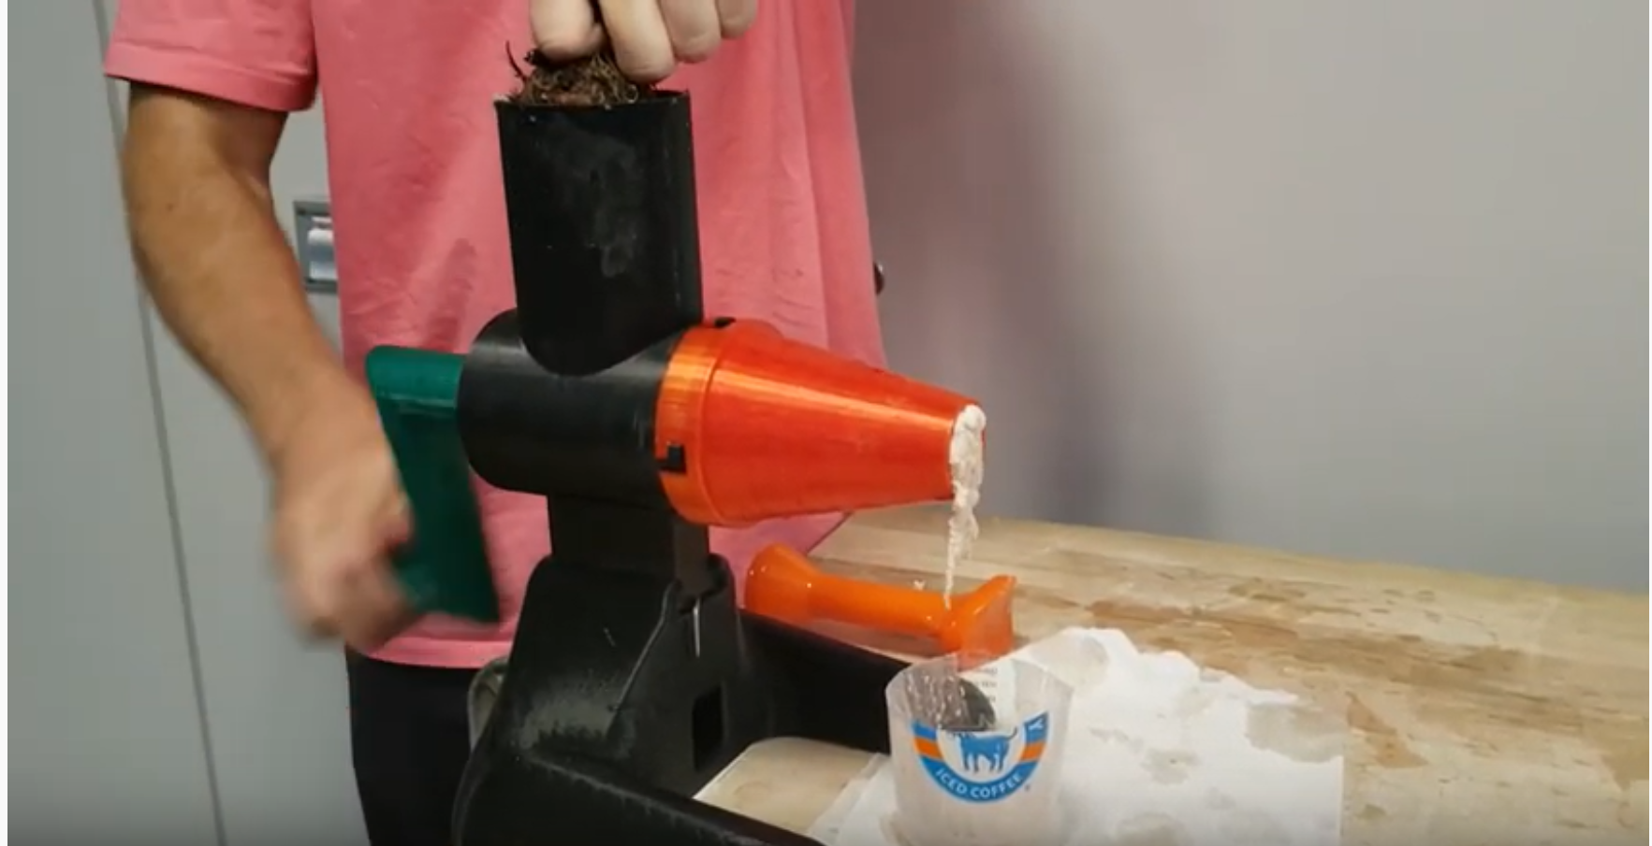

Project Description
9 October 2019
Cocoyam dispenser and roller
Improve upon current hand rolling technique
Help West and Central African Communities
Transfer of technology and knowledge
Client- Isaac Zama - Humanitarian
Mentor - Chuck Vallance
Sponsor - W.L. Gore
Figure 1: Manual grinder by Georgia Tech [1]
Figure 2: Raw Cocoyam [2]
Morrison 3

Slide 4
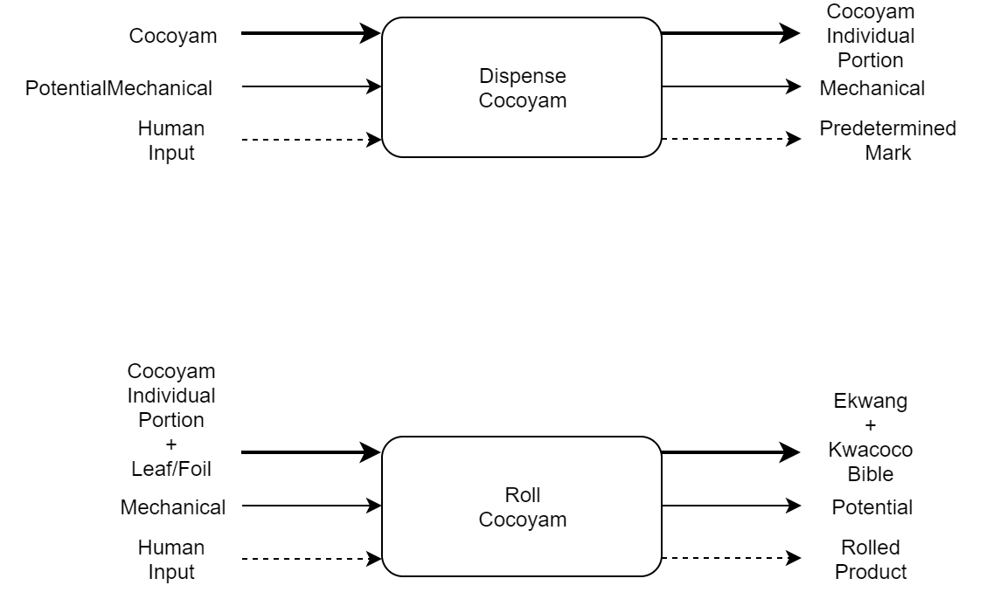
Black Box
9 October 2019
Figure 3 : Black Box Model
Morrison 4

Slide 5
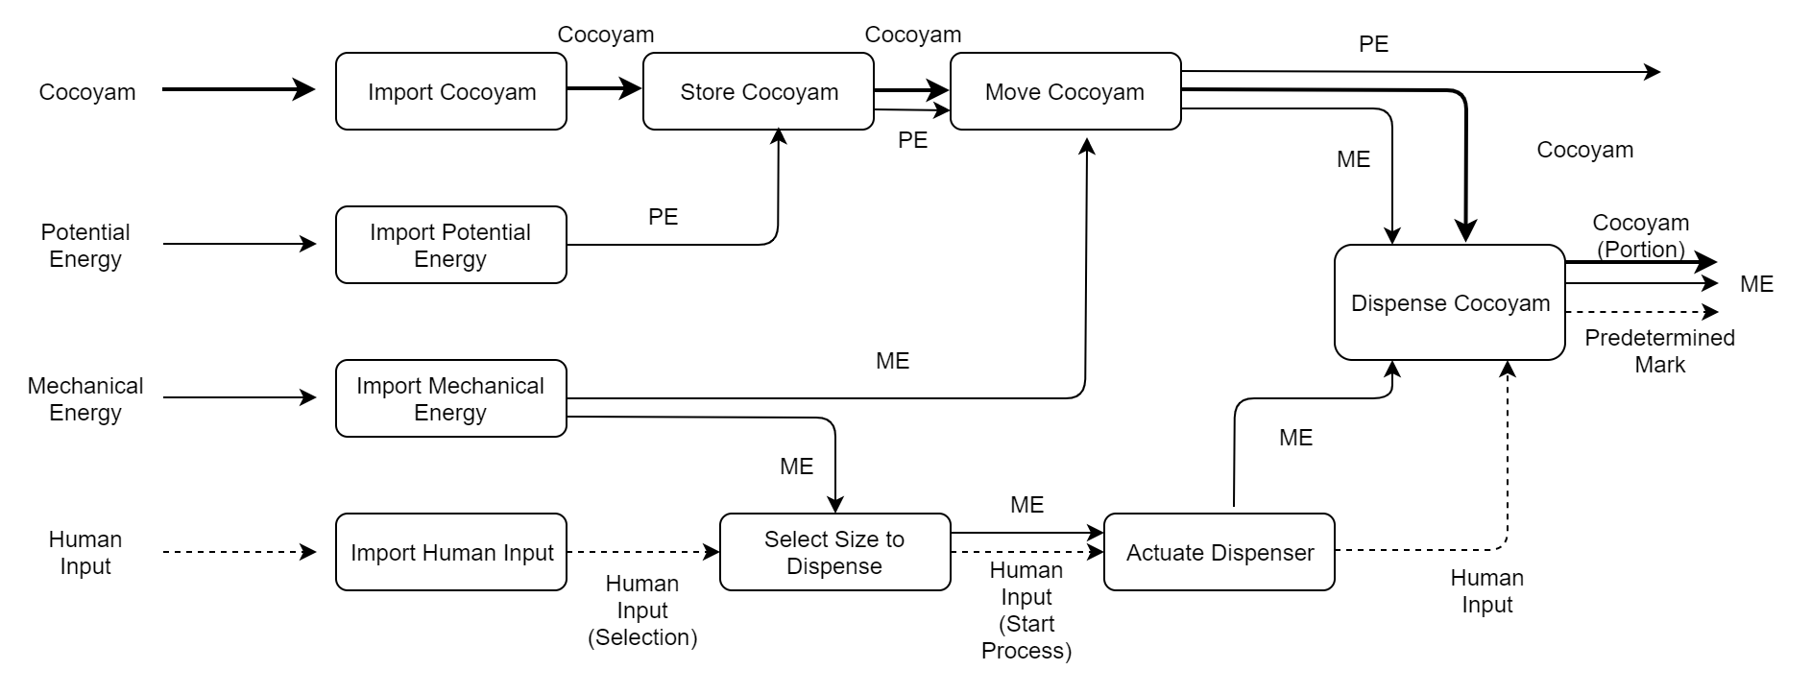
Functional Decomposition: Dispenser
9 October 2019
Figure 4: Dispenser Functional Decomposition Model
Morrison 5

Slide 6
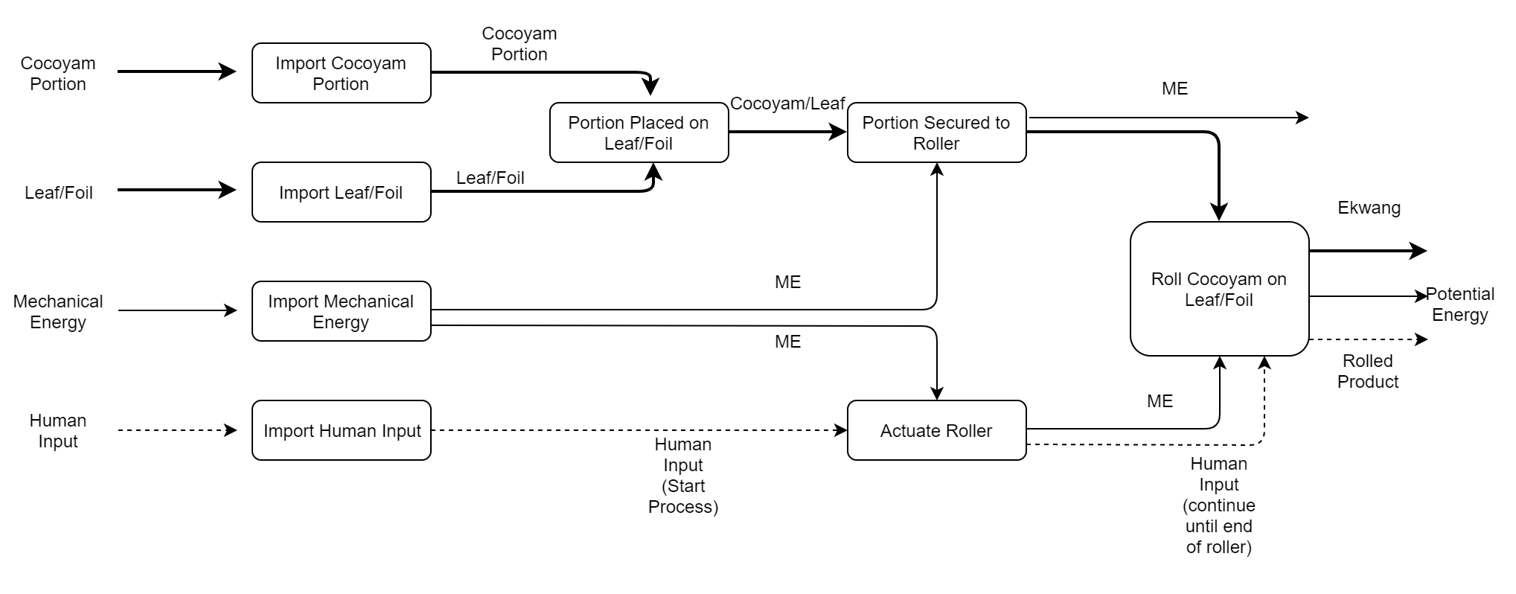
Functional Decomposition - Roller
9 October 2019
Figure 5: Roller Functional Decomposition Model
Morrison 6

Slide 7
Concept Generation
9 October 2019
Concepts of designs were generated using:
Gallery method
Brainstorming
Al-Balool 7

Slide 8
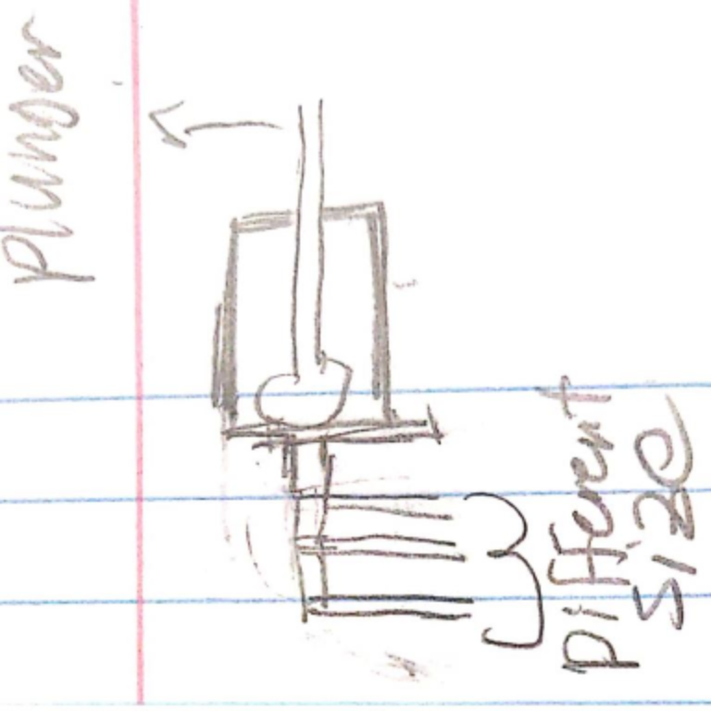
Concepts for Dispensing
9 October 2019
Advantage:
3 part assembly
Large reservoir of cocoyam mixture
Has a wide base to hold the container for stabilization
Disadvantages:
Tabs can be easily broken
Difficult to dispense a pre-measured amount
Figure 6 : Dispensing method 1
Al-Balool 8

Slide 9
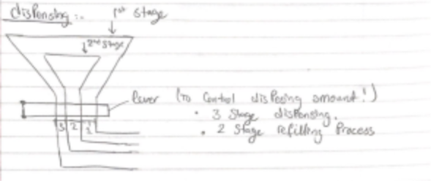
Dispensing Concept Continued
9 October 2019
Advantages:
Strong design withstands pressure
Multiple dispensing methods
Disadvantages:
High cost to manufacture
Fixed capacity
Figure 7 : Dispensing method 2
Al-Balool 9

Slide 10
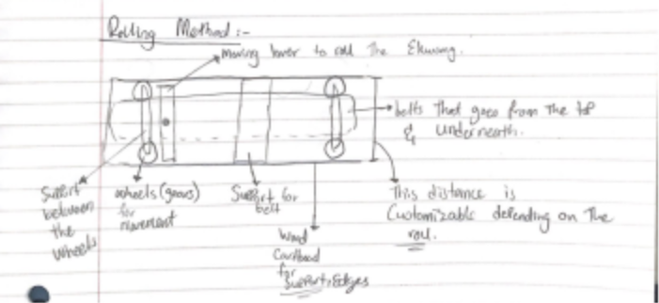
Concepts for Rolling
9 October 2019
Advantages:
Strong design to withstand high forces
Intuitive to use
Disadvantages:
Larger design would lead to heavy parts
Fixed roll size (not adjustable)
Figure 8 : Rolling method 1
Al-Balool 10

Slide 11
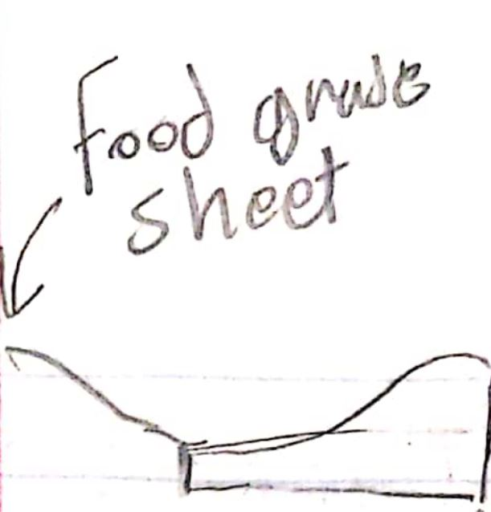
Rolling concepts continued
9 October 2019
Advantages:
2 part assembly
Material readily available(silicon sheet)
Disadvantages:
Easy to deform (can’t withstand high force)
Same time as regular rolling method
Figure 9 : Rolling method 2
Al-Balool 11

Slide 12
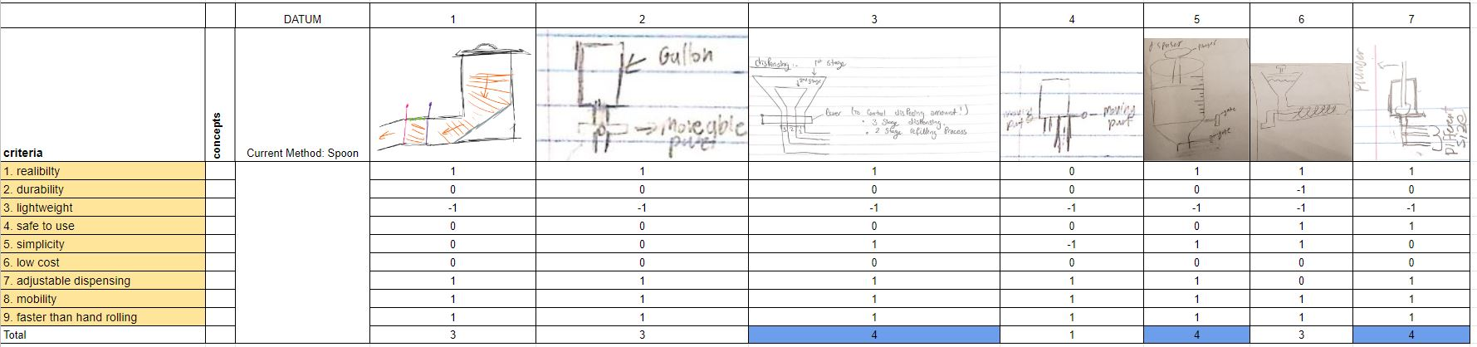
Concept Evaluation - Pugh Charts
9 October 2019
Figure 10 : Pugh Chart for dispensing method
Alanjari 12

Slide 13
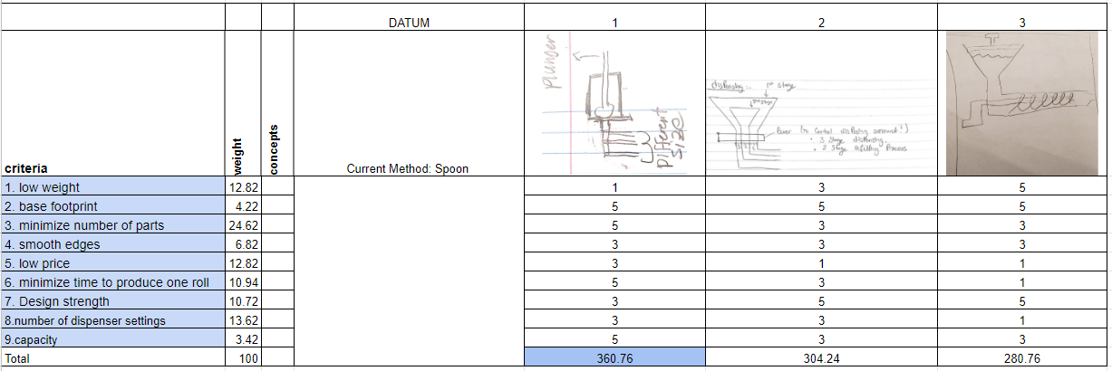
Concept Evaluation - Decision matrix
9 October 2019
Figure 12 : Decision matrix for dispensing method
Alanjari 13

Slide 14
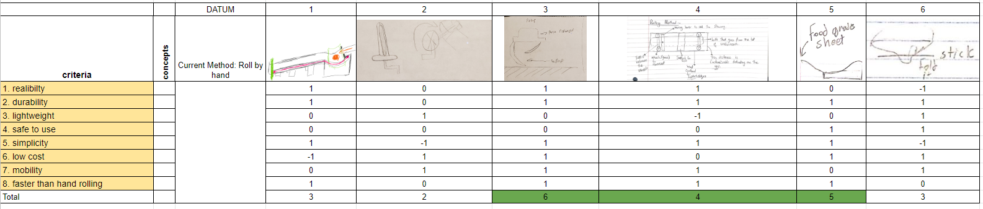
Concept Evaluation - Pugh Charts
9 October 2019
Figure 11: Pugh Chart for rolling method
Des Vignes 14

Slide 15
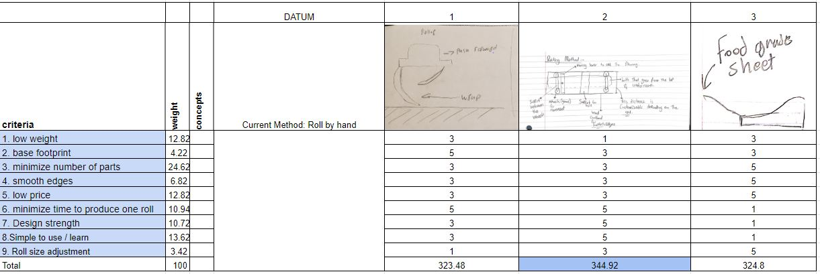
Concept Evaluation - Decision matrix
9 October 2019
Figure 13 : Decision matrix for rolling method
Des Vignes 15

Slide 16
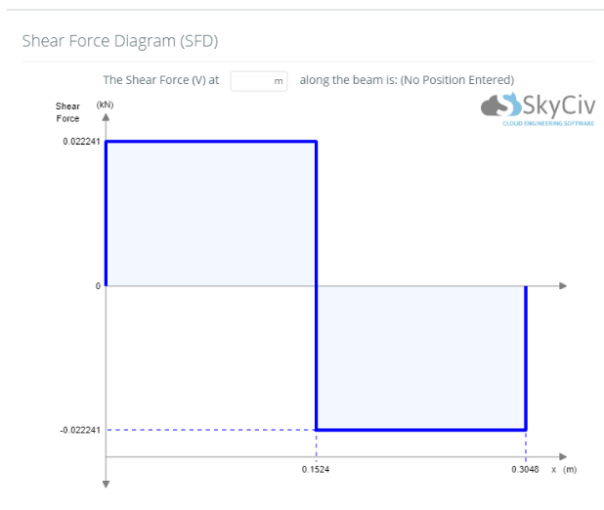
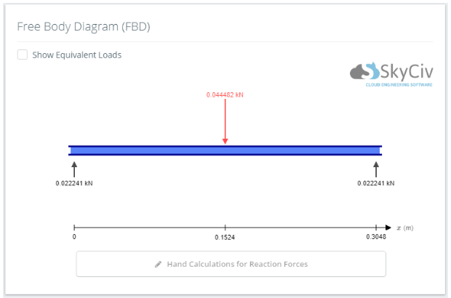
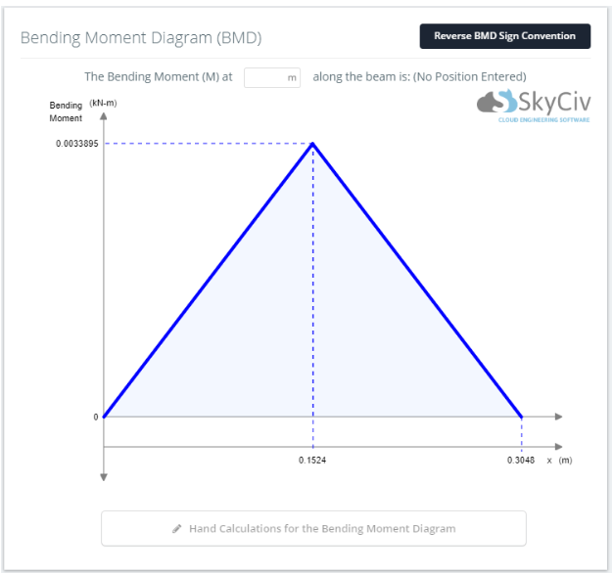
Back of the Envelope Calculations
One calculation was aimed to find the expected forces the design would experience while being used to roll Cocoyam
Another evaluated the cost and resources available to manufacture design
Figure 14 : Free body diagram [3]
Figure 15 : Bending moment diagram [3]
Figure 16 : Shear force diagram [3]
Des Vignes 16

Slide 17
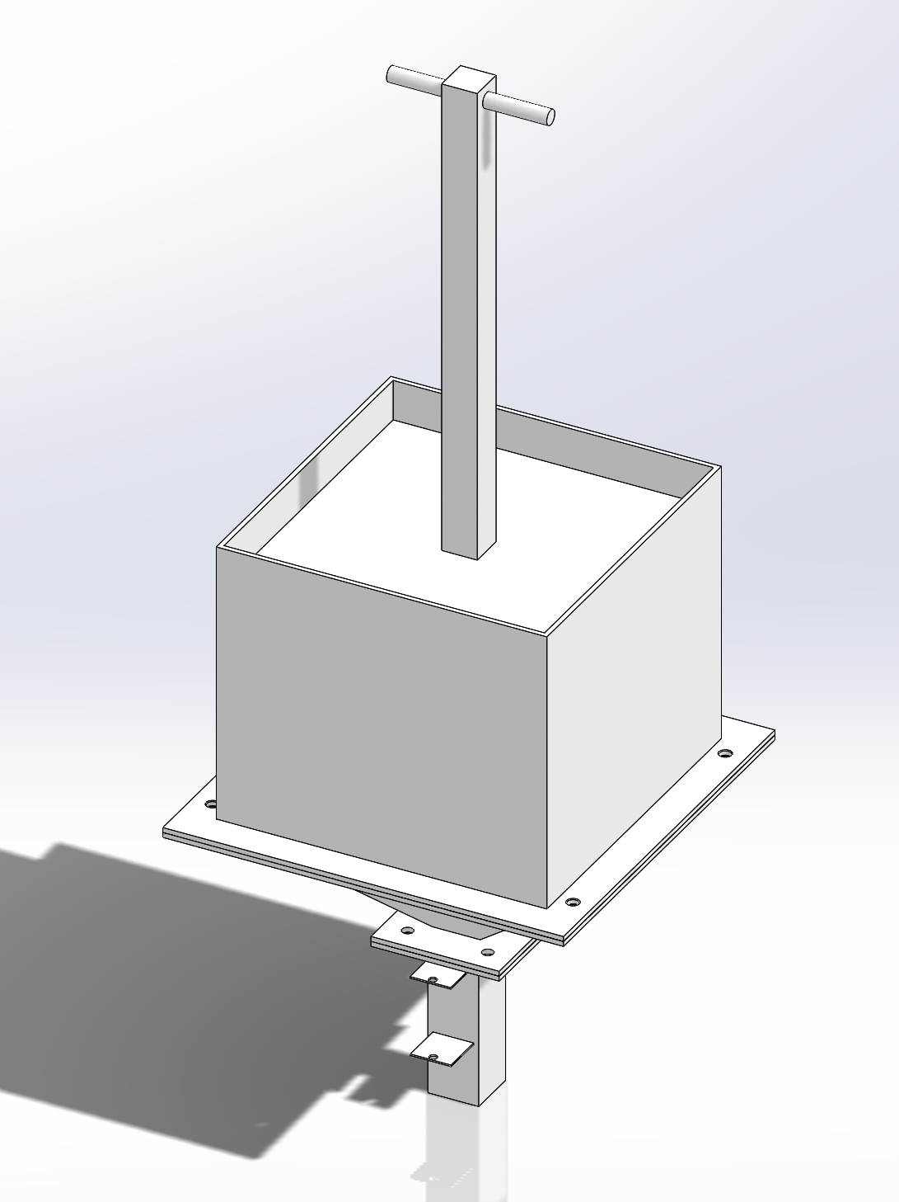
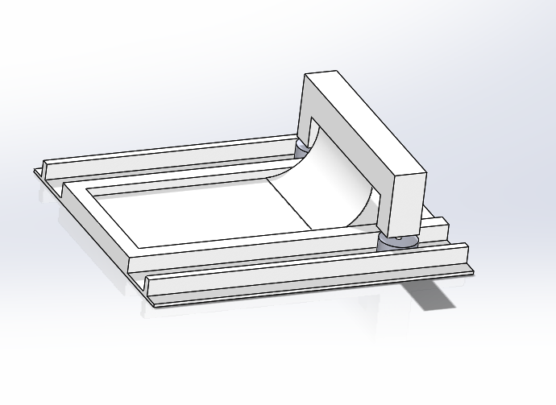
CAD Model
9 October 2019
Figure 17 : Dispenser Preliminary Design
Figure 18 : Roller Preliminary Design
Des Vignes 17

Slide 18
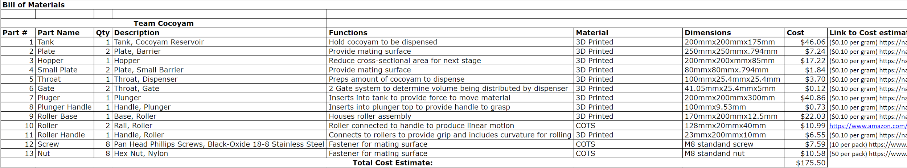
Bill of Materials And Budget Allocation
9 October 2019
Table 1 : Bill of Materials
Total Cost for Prototyping based on BOM : $175.50
Approximate Remaining Budget if produced as-is : $1324.50
Alanjari 18

Slide 19
Questions?
9 October 2019
19

Slide 20
Citations
9 October 2019
[1] Evan Williamson, “Coco-YUM! - The manual cocoyam processor,” YouTube, 23-Jul-2019. [Online]. Available: https://www.youtube.com/watch?v=siXvcSSyxC4#action=share. [Accessed: 15-Sep-2019].
[2]Admin, “Health Benefits and Nutrition of Taro Root,” TAROTO TAIWANESE HEALTHY DESSERT. [Online]. Available: https://tarotodessert.com/en/2017/health-benefits-and-nutrition-of-taro-root/. [Accessed: 17-Sep-2019].
[3] "SkyCiv Platform", Platform.skyciv.com, 2019. [Online]. Available: https://platform.skyciv.com/beam. [Accessed: 08- Oct- 2019].
[4] SolidWorks, Education Edition, Dassult Systems, 2019.
[5] Grainger, "Grainger Products," [Online]. Available: https://www.grainger.com/product/GRAINGER-APPROVED-Aluminum-Sheet-Stock-15V222?cm_sp=Product_Details-_-Products_Based_on_Your_Search-_-IDPPLARECS&cm_vc=IDPPLARECS. [Accessed 8 October 2019].
20

